Slide 1

STOCKPILE VALIDATION & VALUATION
Hamill Marinda and Gabe Tiano

Slide 2
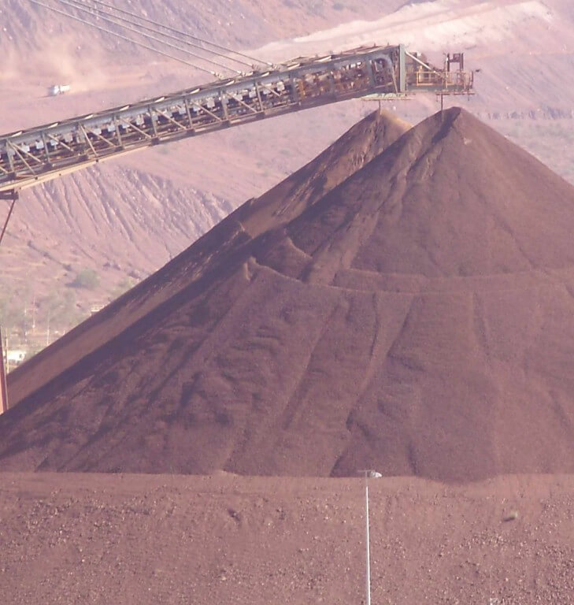
NEEDFINDING
Stockpile Validation
Stockpile Surveying
Volume Calculation
3d Modelling/DEM

Slide 3
Interview
Online research through videos how surveying is done
Witness first hand the equipment used by professional surveyors
How did we examine it and in what method ?

Slide 4
Discovered breakdown
Data Acquisition is slow because of the following reason:
The equipment is heavy, bulky and expensive
The object being surveyed is huge and uneven in shape
The environment is harsh
Due to time constraint, surveyors do random sampling to represent the whole stockyard which affects the accuracy
Safety concern of the surveyors
Generating output which is volume and its 3D model requires:
Expertise of the Computer Aided Design Software

Slide 5
Point of View
Volume Validation would be easier, more efficient, and more accurate if there will be a device that can use remotely and can conduct the data collection aerially. Also, if there is an application that can automatically generate the output such as 3D Model and calculate the Area, Volume, Cut and Fill.

Slide 6
STORYBOARD
The story board will help us visually understand the problem the surveyors in dealing with the task

Slide 7
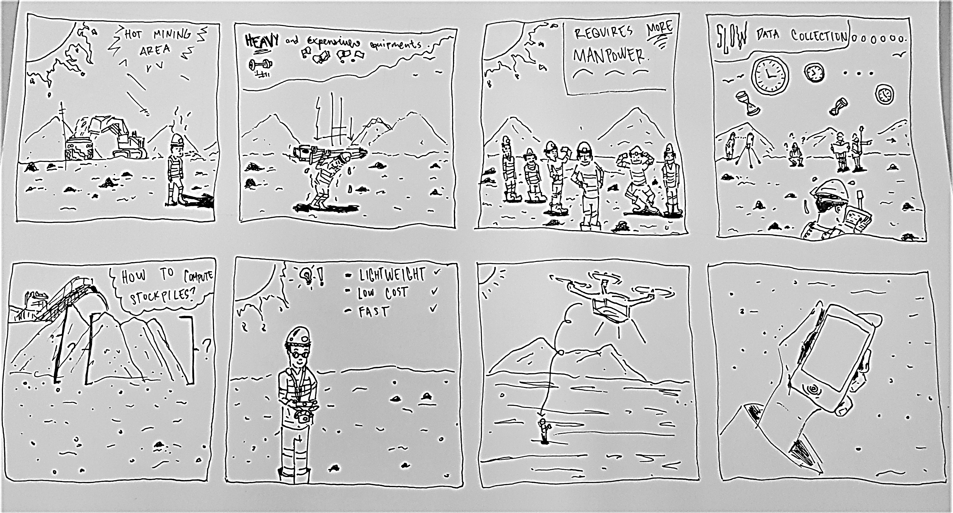
THE PROBLEM

Slide 8
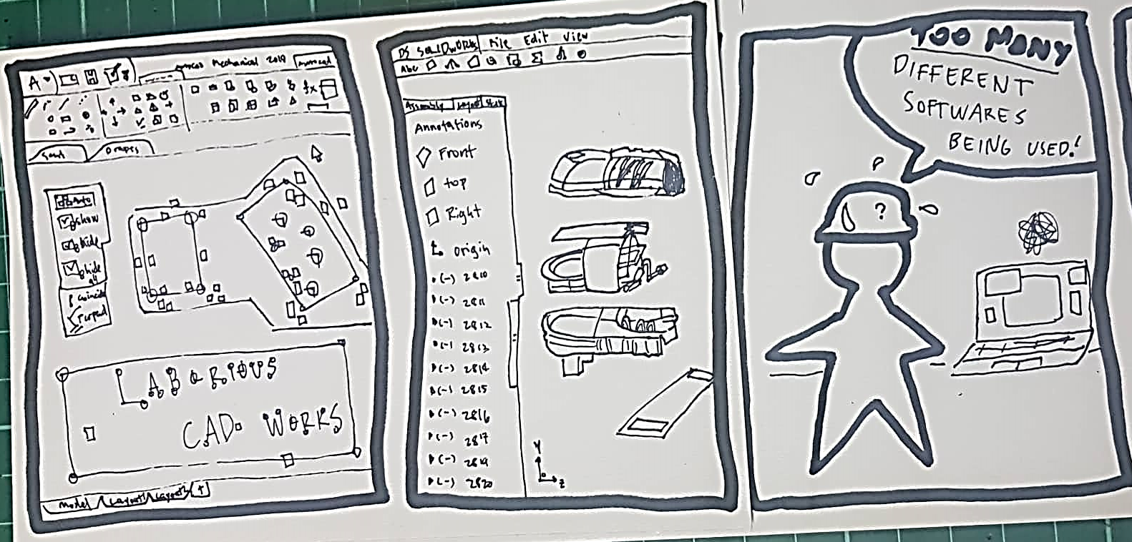
THE PROBLEM

Slide 9
THE SOLUTION

Slide 10
PROTOTYPE

Slide 11
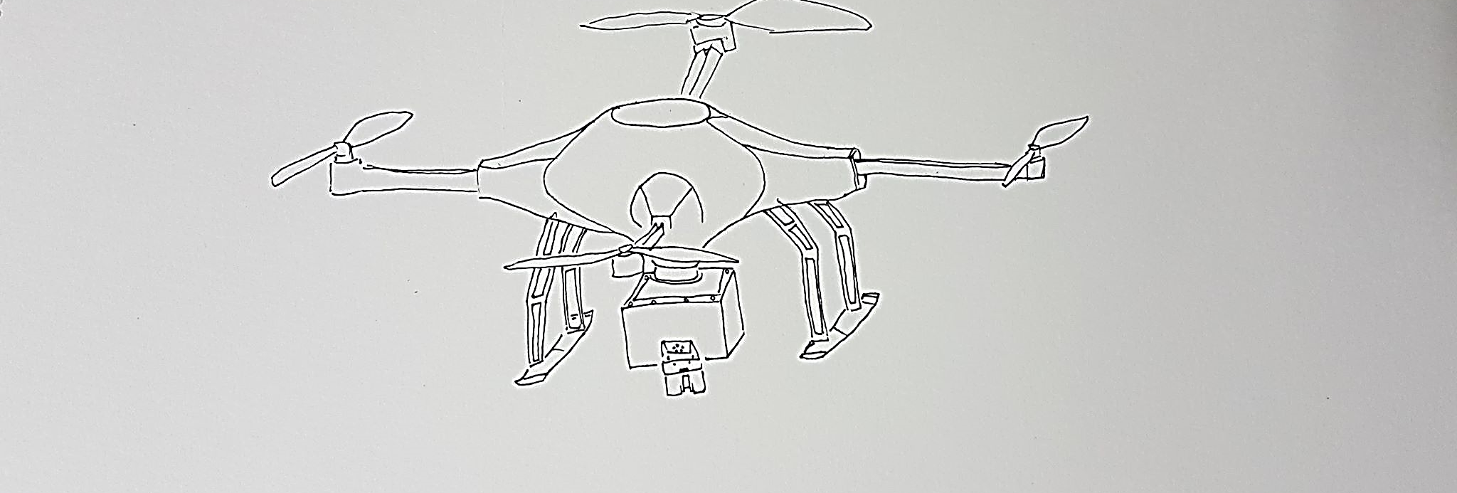
Surveying Device Prototype

Slide 12
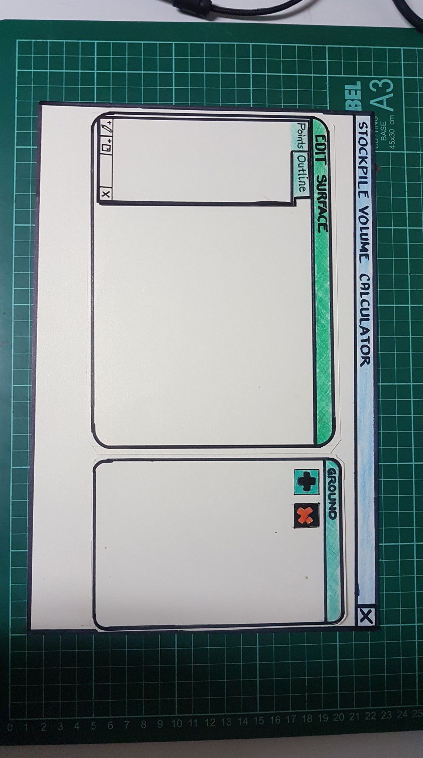
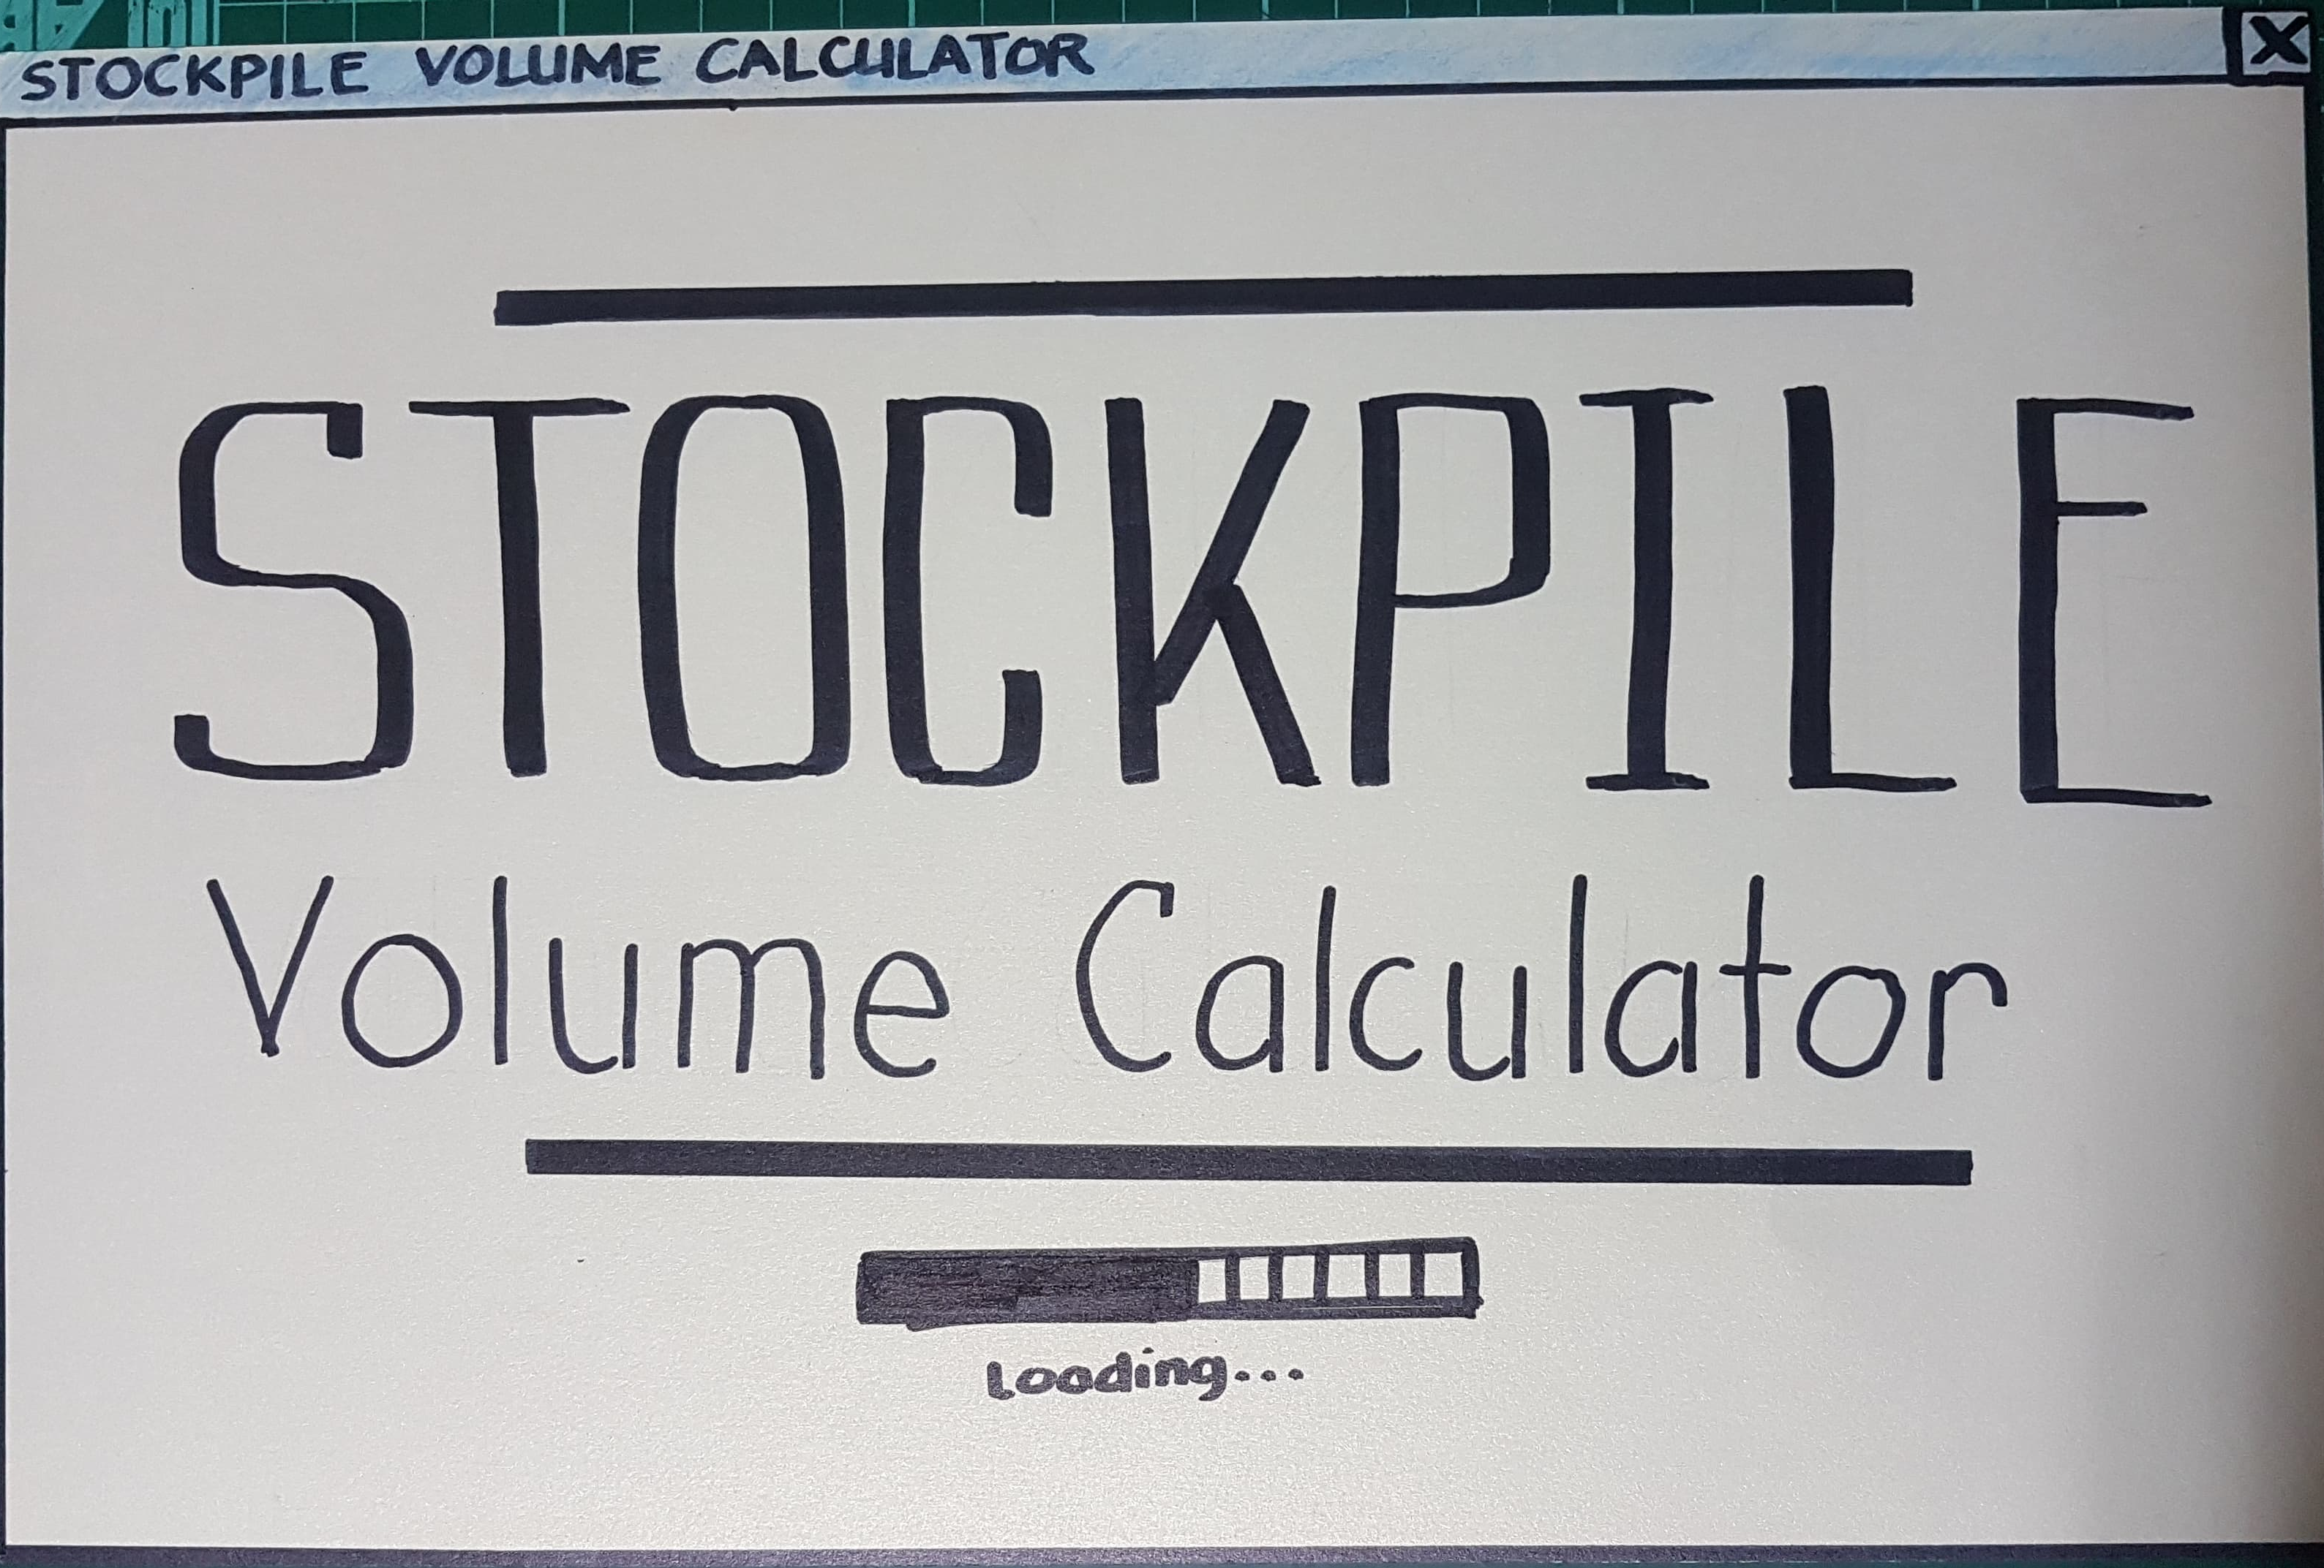
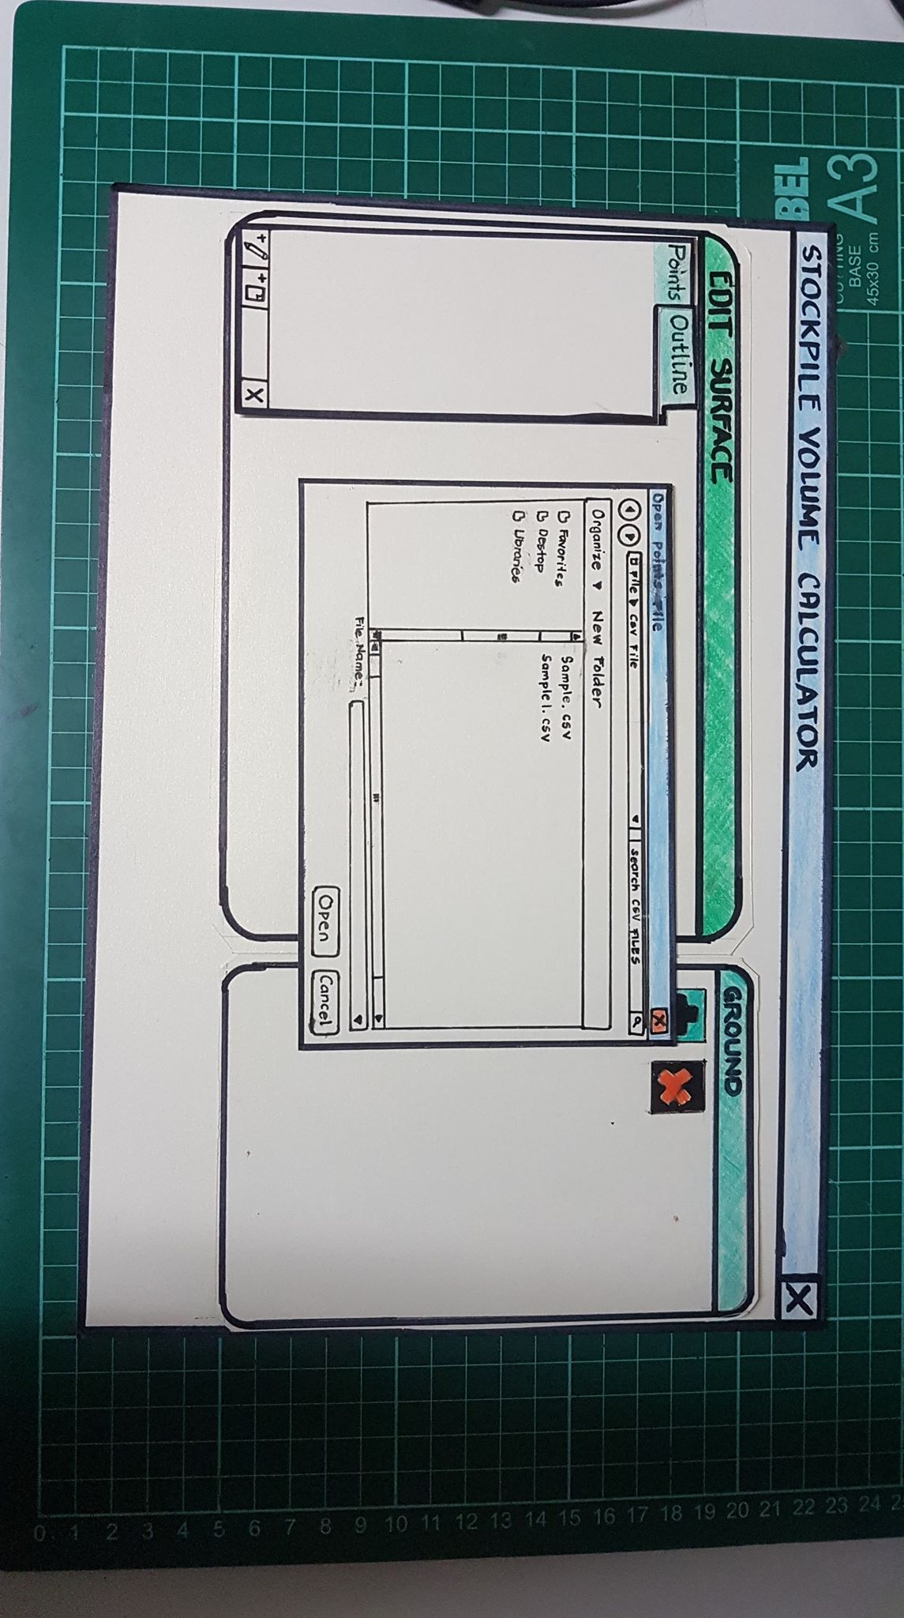
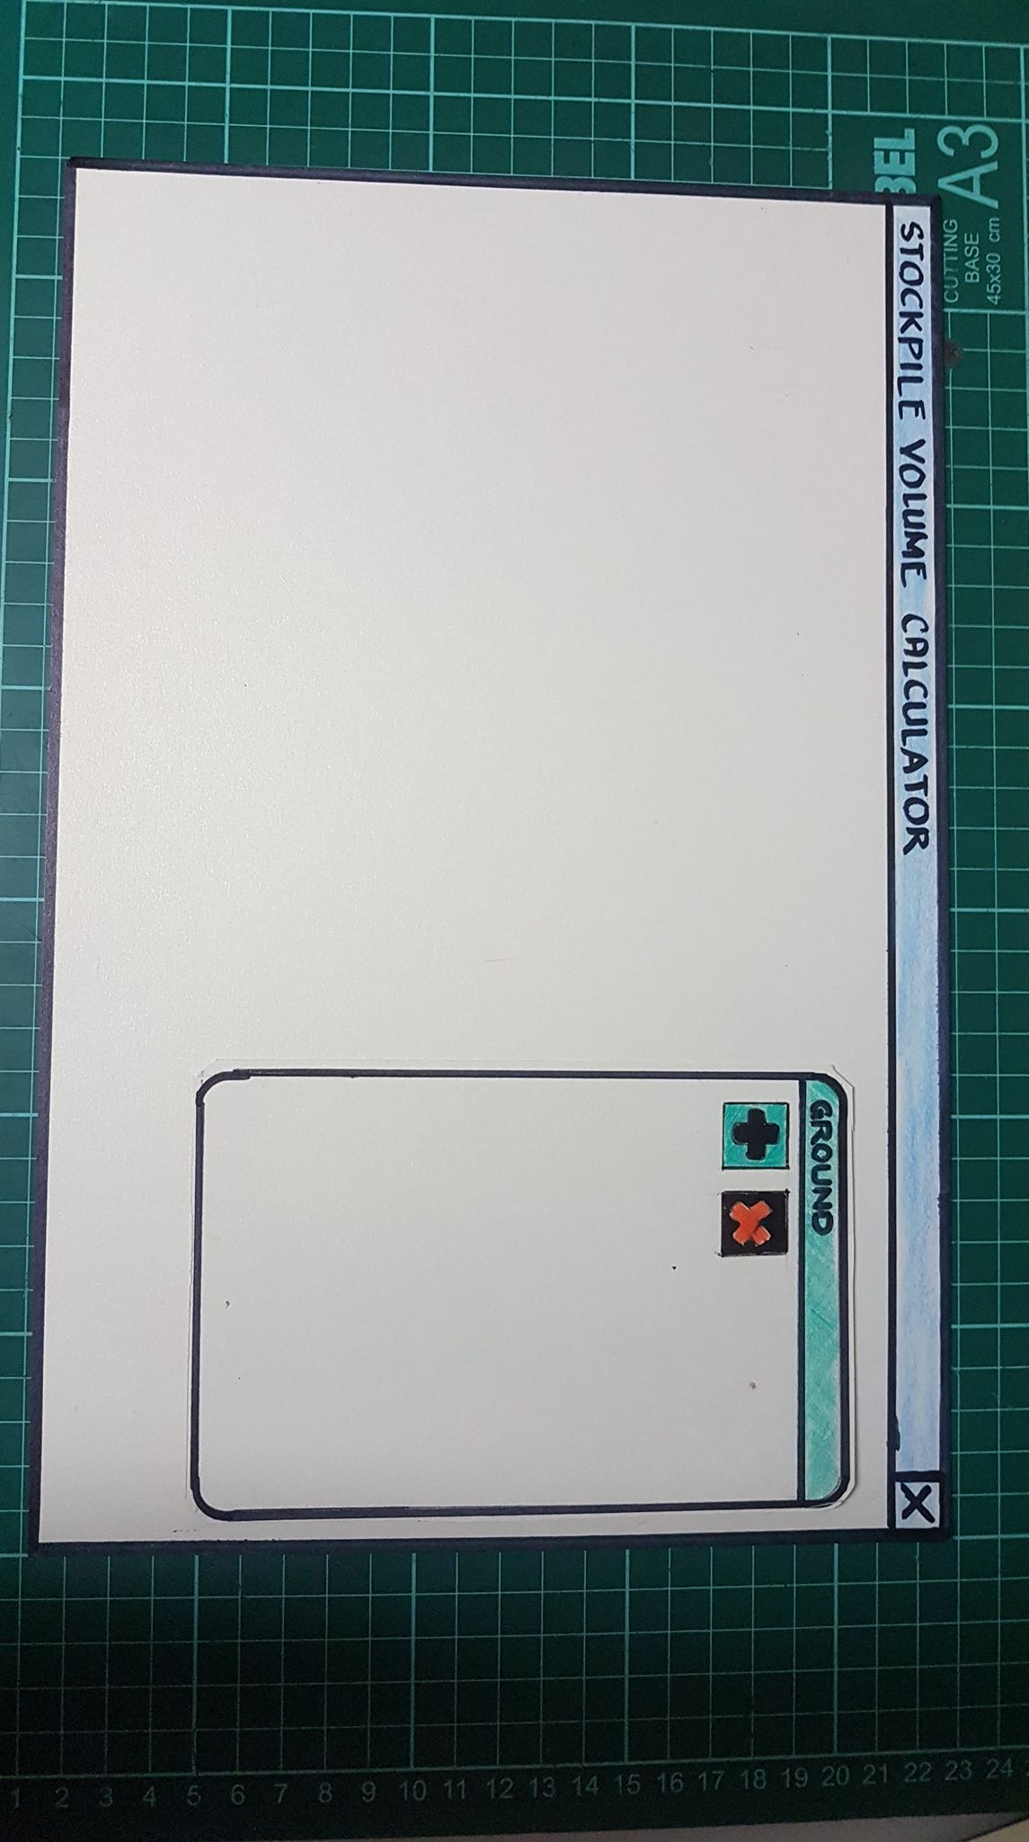

Slide 13
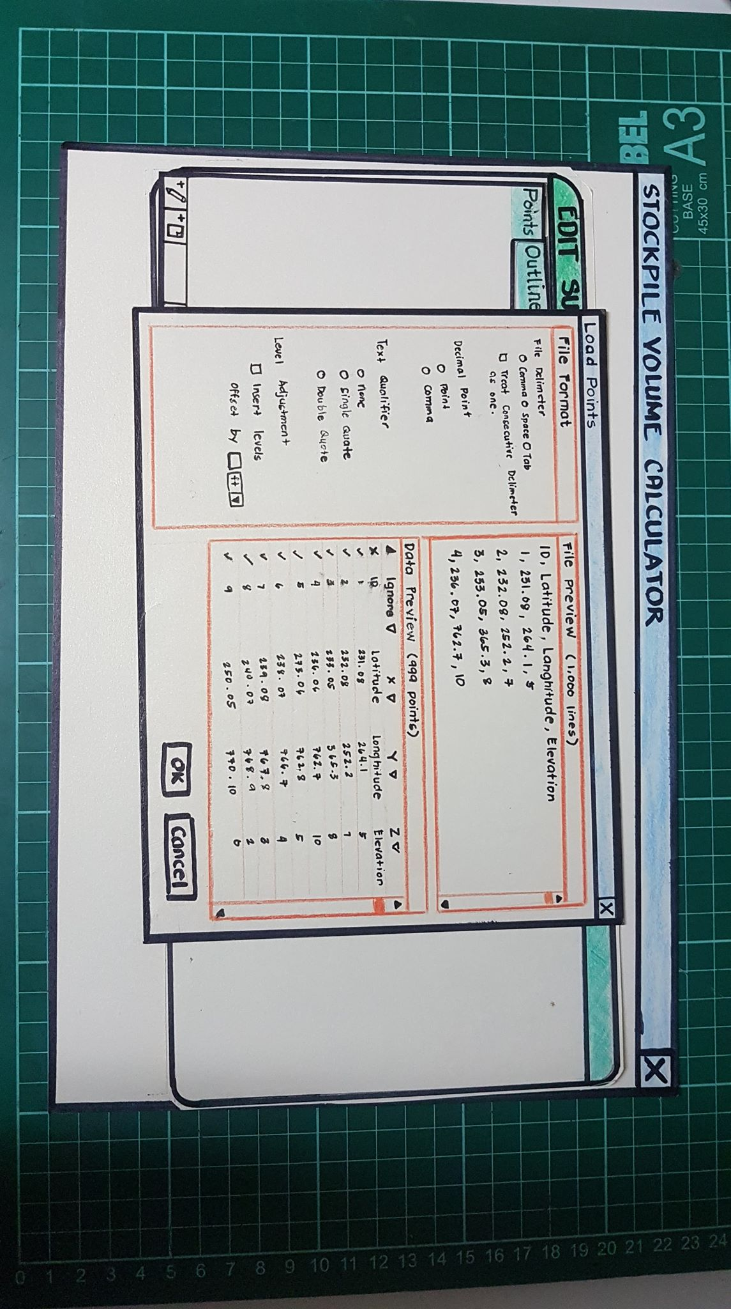
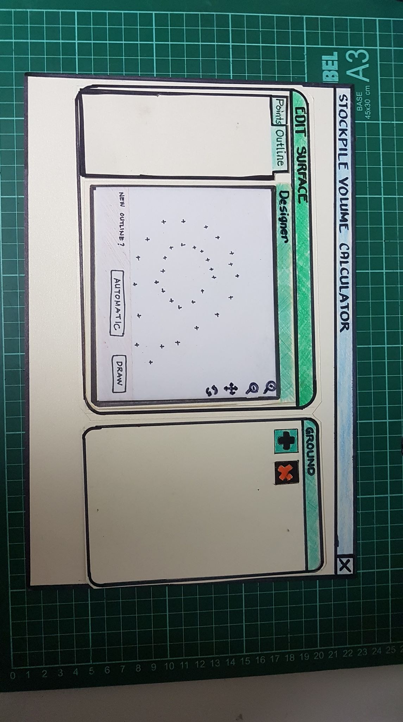
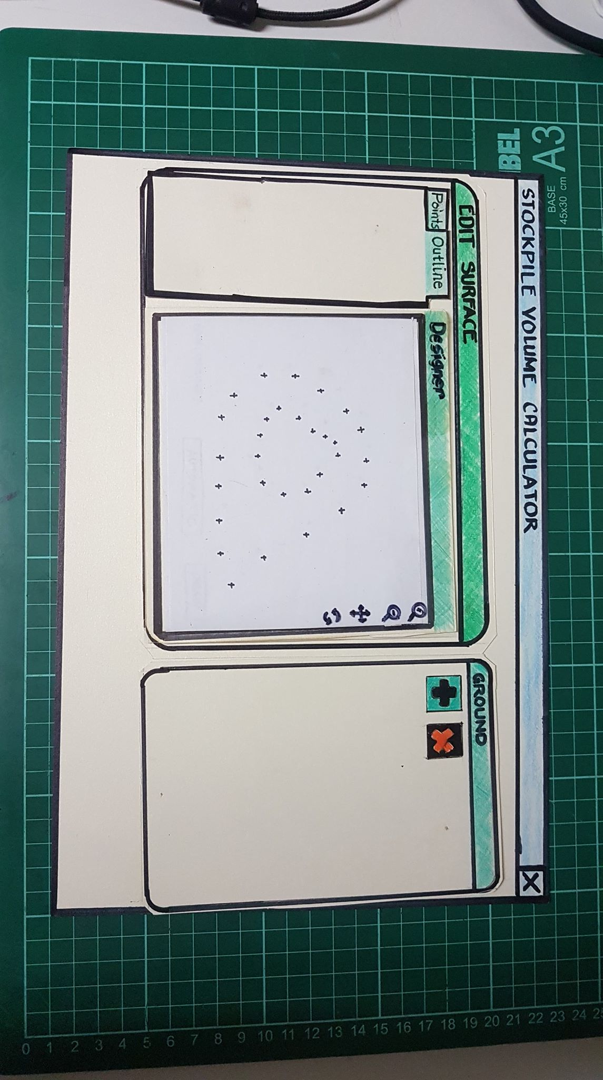
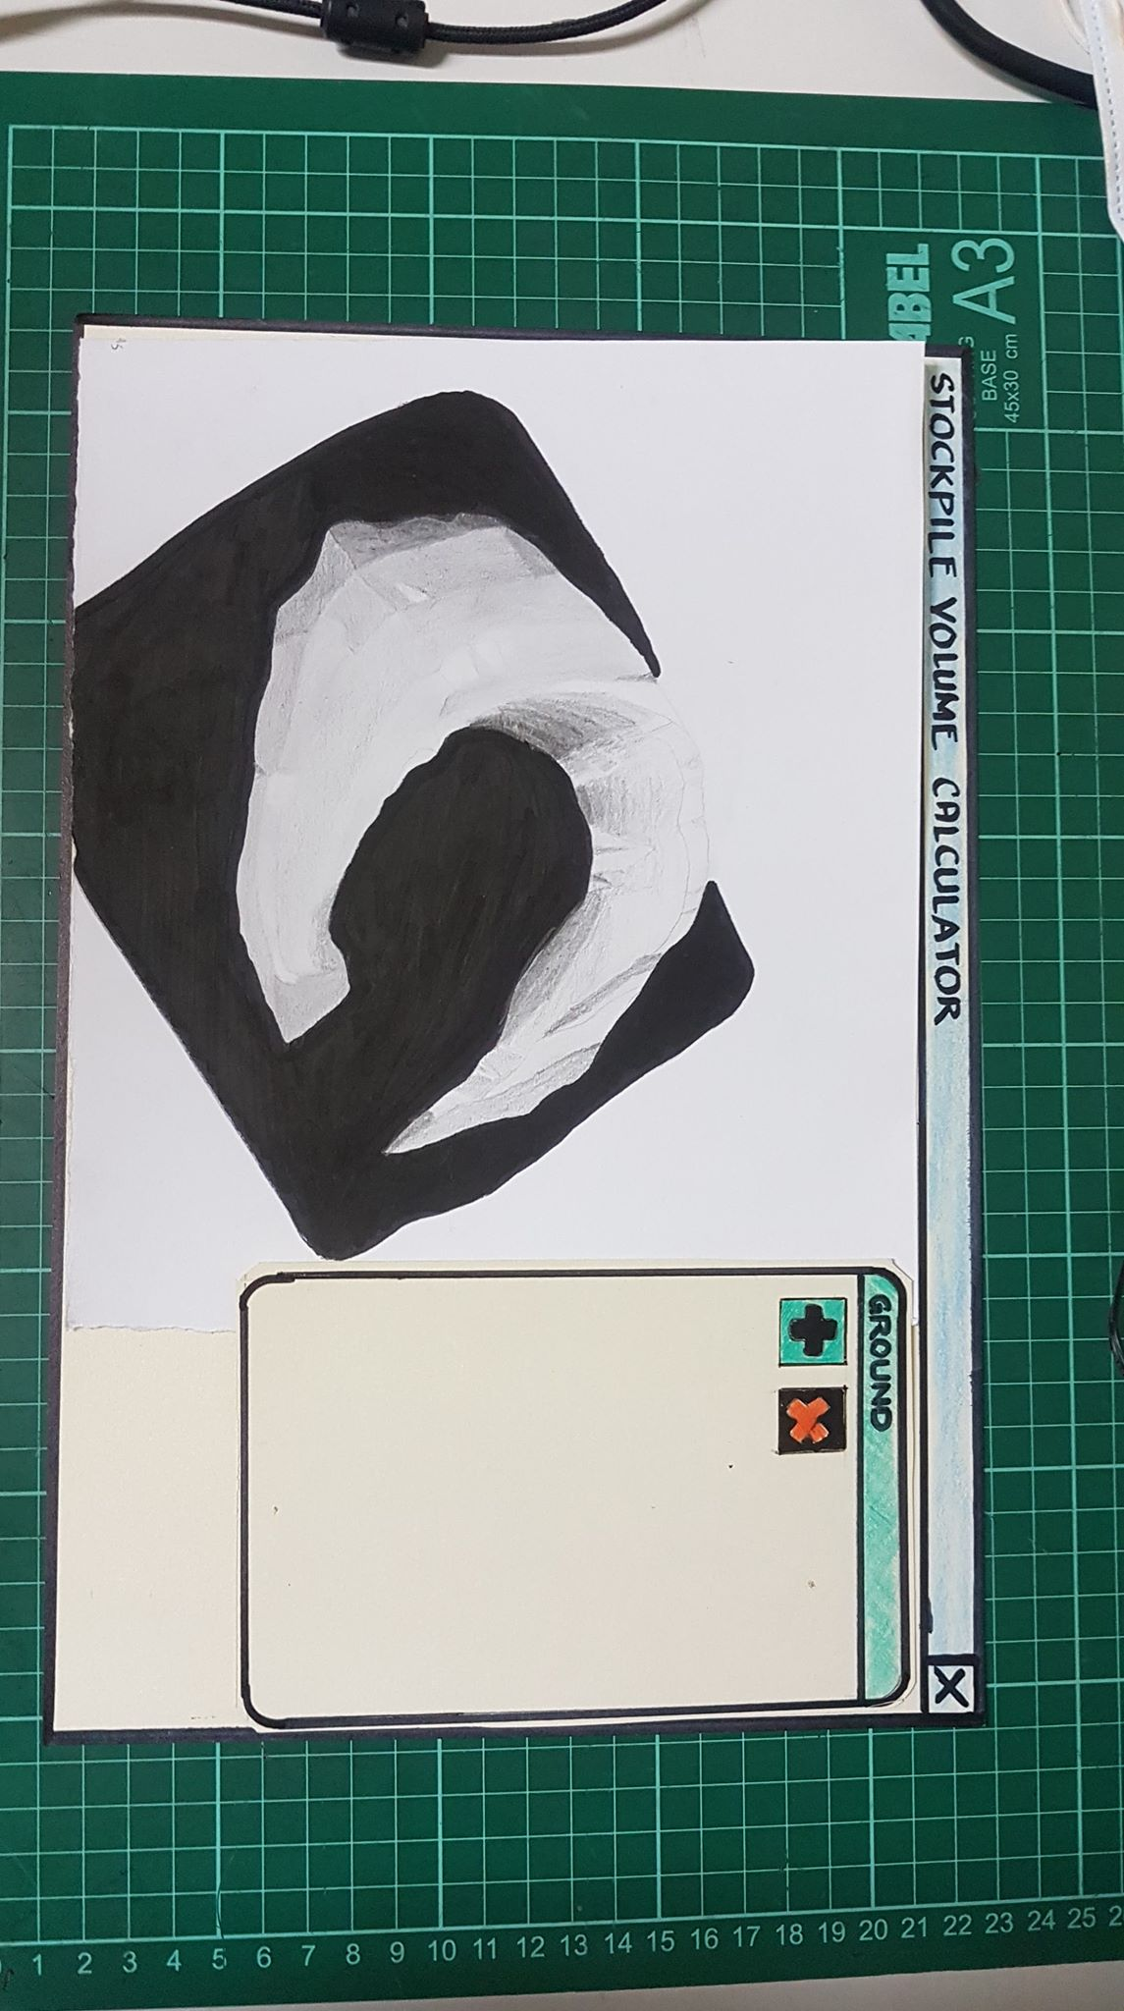
Volume: 45,000 ft cu
Area: 13,000 ft sq

Slide 14
Thank You!

